Slide 1
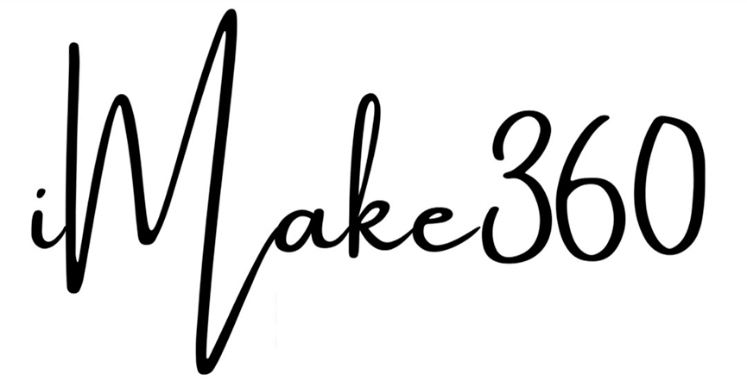
Personal & Organization Distinction Assessment

Slide 2
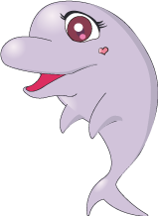
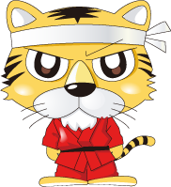
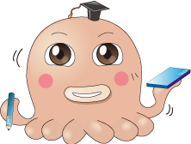
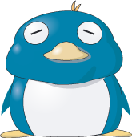
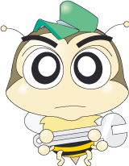
PODA Personal & Organization Distinction Assessment
Dolphin
Tiger
Octopus
Enthusiastic
Sharing
Optimistic
Brave
Challenging
Proactive
Integrative
Comprehensive
Flexible
Penguin
Honeybee
Patience
Harmonious
Cooperative
Quality
Procedure
Division of Labor

Slide 3
PODA Assessments

Slide 4
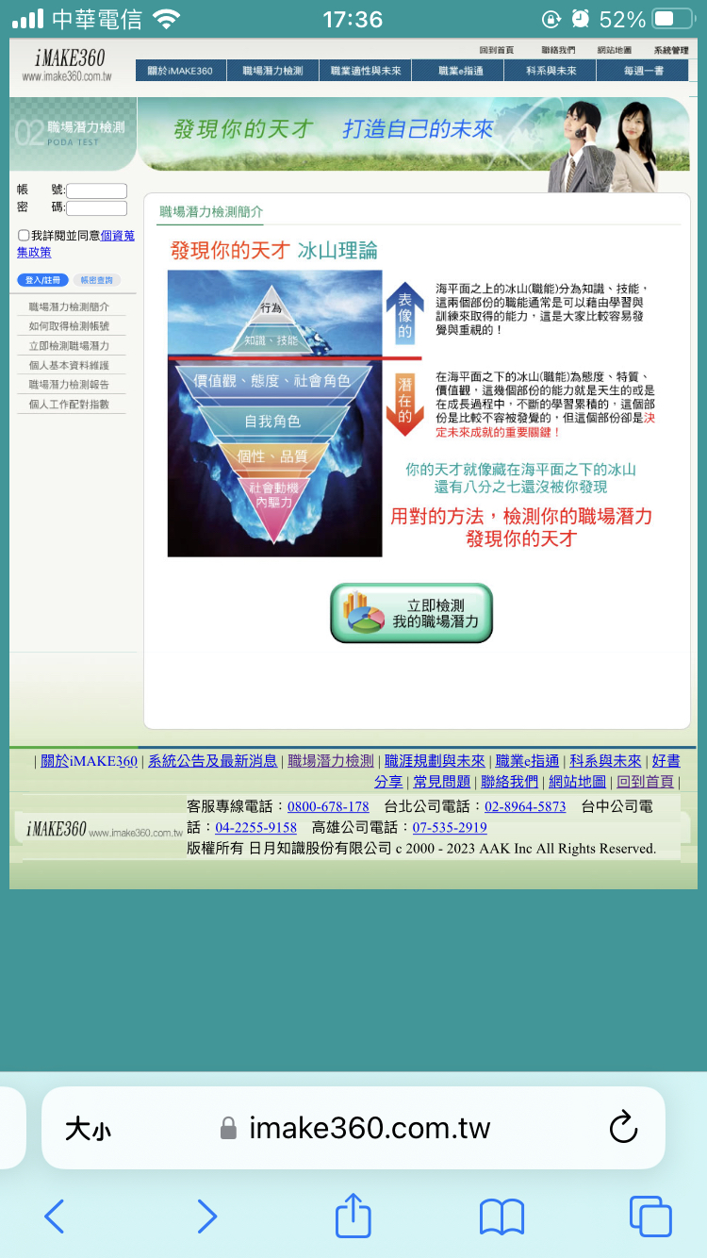
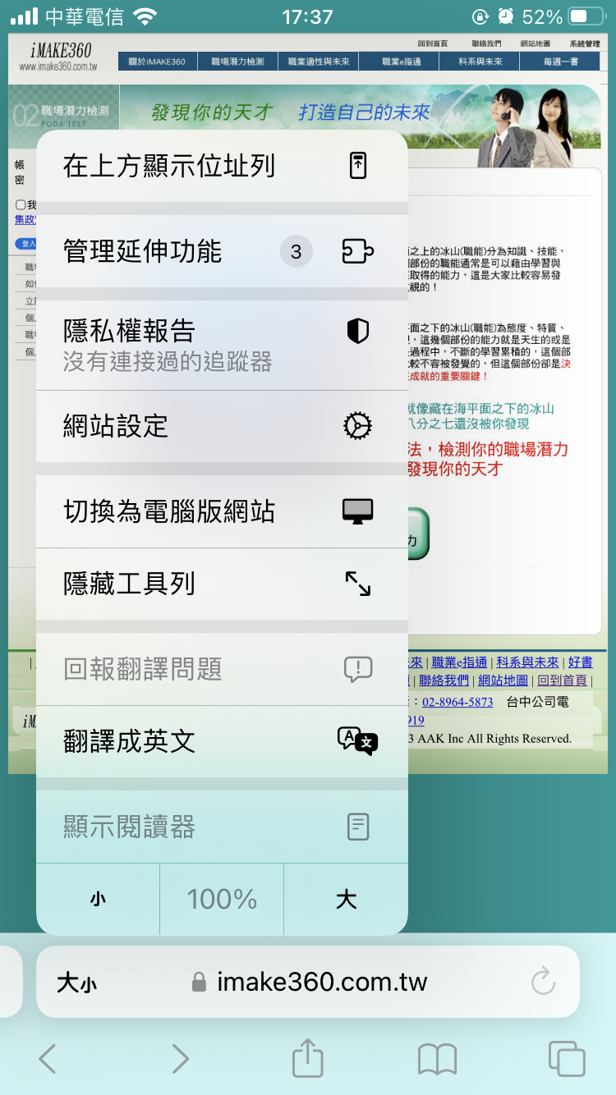
Translate Website
1
2

Slide 5
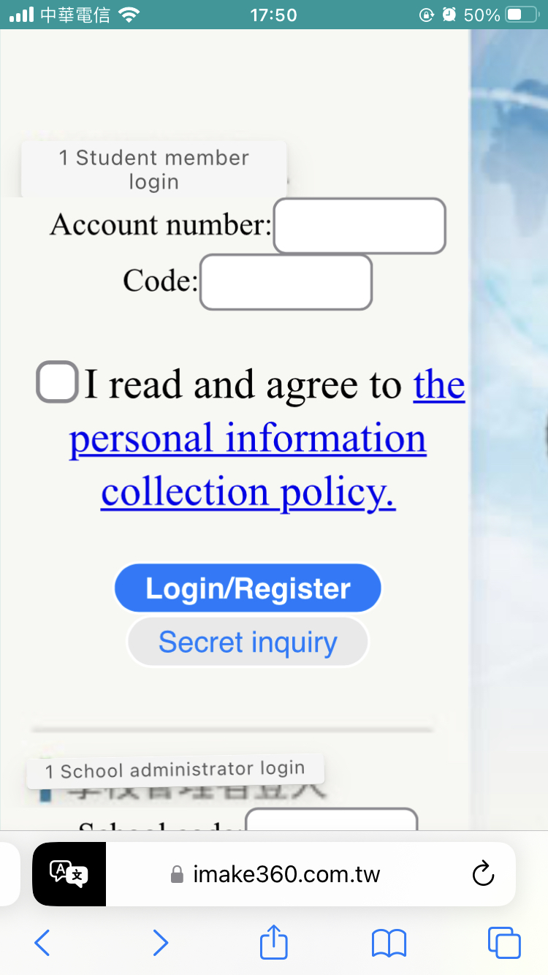
Enter Log In & Password

Slide 7
When you fill out the survey, please put aside your roles in school and family.
Feel the "unarmed", "pressure-free", "most comfortable", and "natural" self.
This "self" is not the expected self, nor is it the self when you are with certain people, doing certain things, or in certain situations. It is the self that is the most comfortable, the most real, and the most complete in most situations.
Click to Start

Slide 8
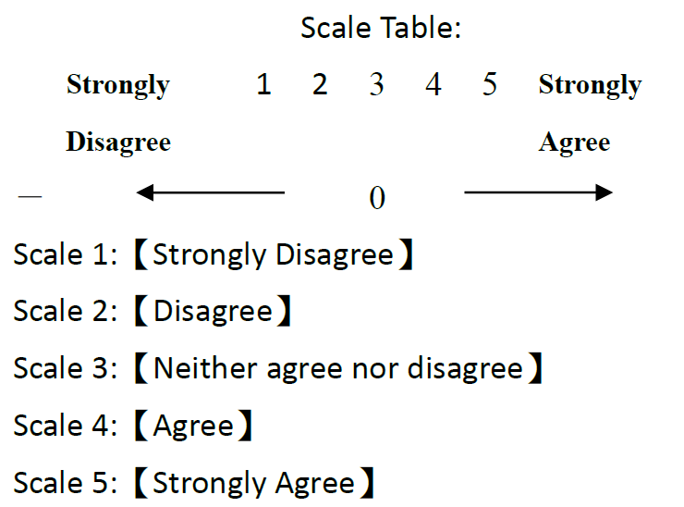

Slide 9
Just use your intuition to answer

Slide 11
Questions

